Slide 1



| Analytic
Team survey

Slide 2
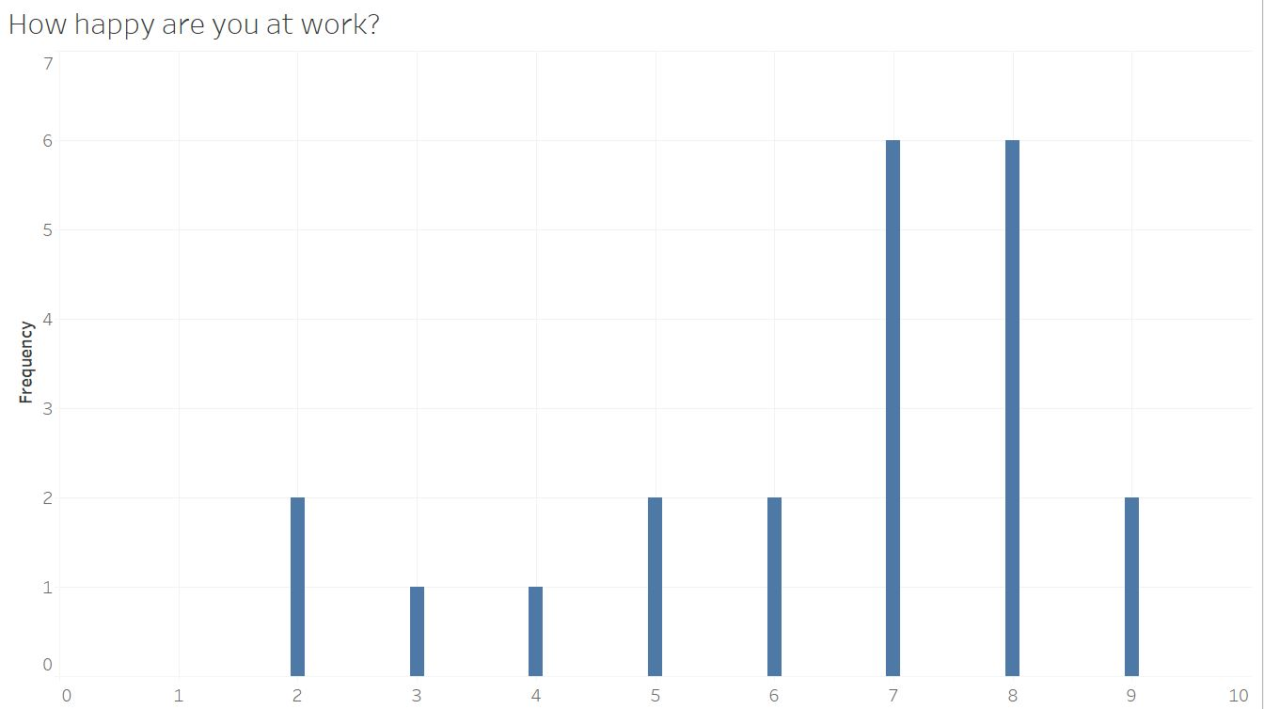
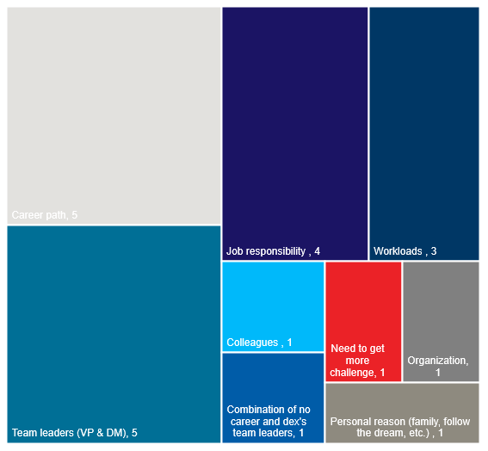
Summary of Data
Over All Happiness
Reason to Quit
Average Happiness is 6.4 / 10
Lowest score is
“Do you and your colleagues OUTSIDE of dEX team work to achieve the same goals? “
Highest score is
“Are you fully empowered and accountable for the work that you do?“
Unhappy
Neutral
Happy

Slide 3
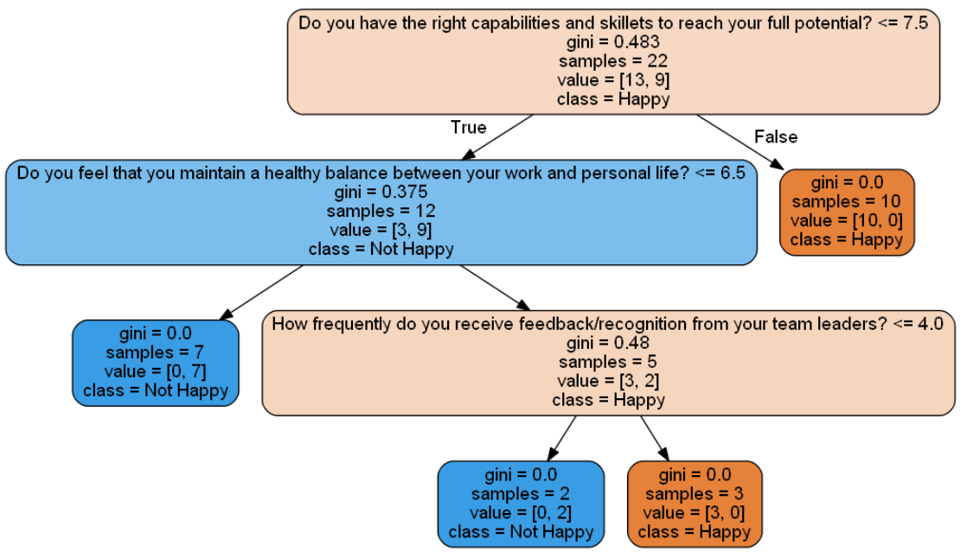


Happiness @ dEX can be enhance by Capabilities and Skillets, Work Life Balance, Team Leader Feedback
Survey
Decision Tree
Overview
Using machine learning to find the most important factor that dictate team member satisfaction. We use Happiness, Trust, Value for GC
Enhacing factor
Capabilities and skillets to reach full potential
Healthy work life balance
Feedback and recognition from your team leader

Slide 4


Thank You

Slide 5
| Analytic
THANK YOU SO MUCH

